Slide 1
KCCA training
Urban Agriculture Project
16.October.2018

Slide 2
Agenda
Deliverables
Go through project (report)
Go through the portal (use and functionality)
Data flow (field collection into excel into portal)
Data structure and naming for portal
UrbanAgPortal (2019 and beyond)
Portal hosting (github/KCCA)

Slide 3
Project Report
?

Slide 4
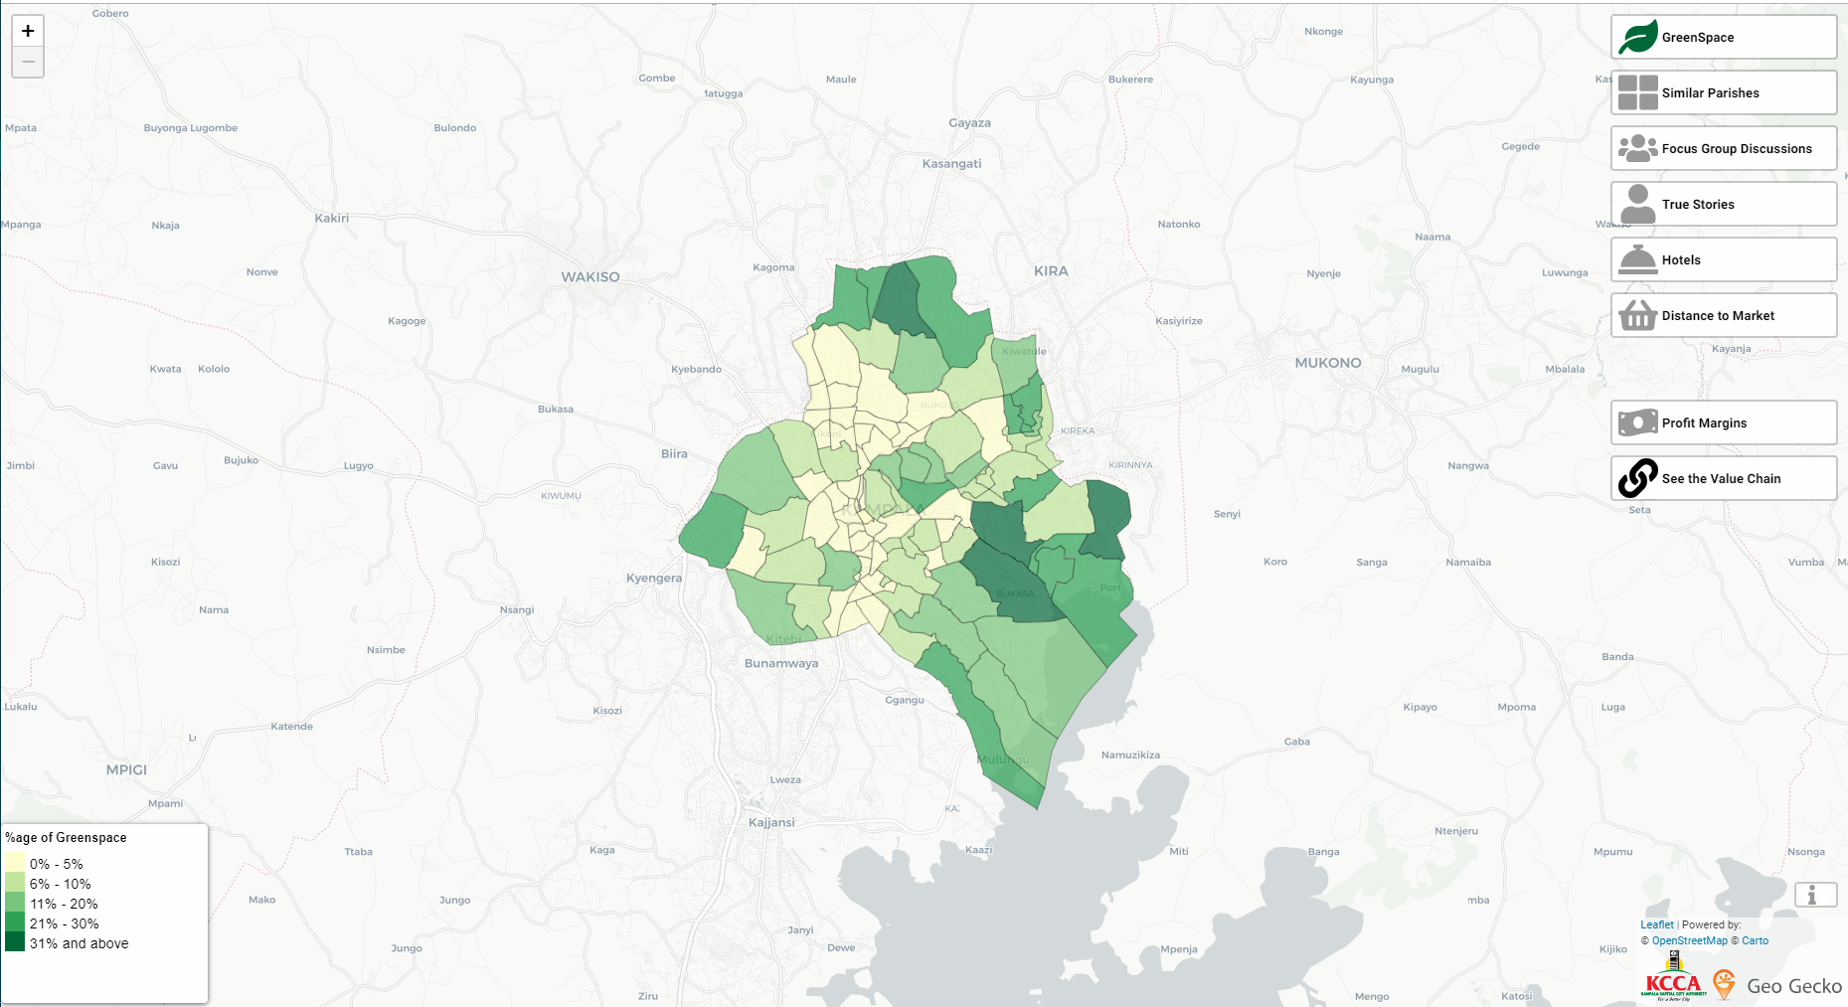
Portal
Go to Portal

Slide 5
Managing Portal Data

Slide 6
Post Training
Documentation on taking data from Kobo sheet to the portal. (Removing and storing sensitive information)

